Slide 1
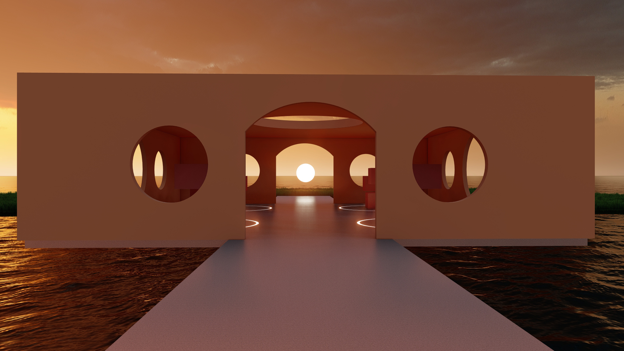
Omnis Company Presentation

Slide 2
Meet the Team
Tara Culver
Co-founder
UX Designer
Giggles a lot
Faridat Ilupeju
Co-founder
UX Designer
Zero chill
Jehlani Pace
Co-founder
Product Manager
Professional Grandpa
Diane Sy
Co-founder
UX Designer
The “chill” one
Katherine Villa
Co-founder
UX Writer
Walking Encyclopedia

Slide 3
Our Mission
We are devoted to helping our customers find the best beauty products for their unique skin needs. We focus on helping you love the skin you’re in.

Slide 4
Our Product
Omnis provides an Augmented and Virtual Reality beauty shopping experience. ​
Our Augmented Reality and Skin Analysis technology empowers individuals to find products that are specific to them.
With health and safety considerations on the rise, consumers increasingly shop for beauty products and use curbside pick-up services. ​
Our services let customers shop from the comfort of their own home while enjoying a unique shopping experience.

Slide 5
Virtual Reality Metaverse

Slide 6
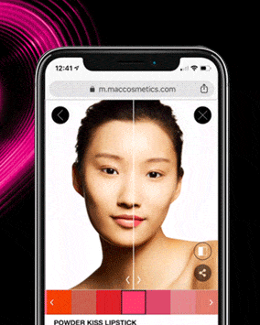
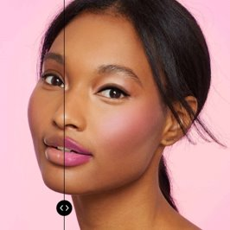
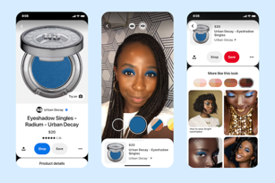
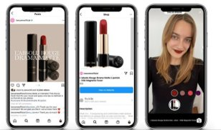
Augmented Reality

Slide 7
Qualitative Research

Slide 8
Purpose
People have difficulty finding beauty products unique to their needs.
We want to learn three key details
Determine interest in Augmented and Virtual Reality beauty shopping experiences.
Understand user pain points.
Understand positive user experiences.

Slide 9
Method
We will be conducting in-depth individual interviews with 5-8 participants. ​
Each interview will last 60 minutes and will be held in a remote setting. ​
There will be one interviewer and one note taker present with each interviewee. ​
We will record each interview after we are given verbal consent by the participant.

Slide 10
Participants
Age group 18-35.
Men and Women
Largest consumer of beauty products.
AR and VR technology familiarity. ​
Insight

Slide 11
Location
Interviews will be conducted remotely via Microsoft Teams. A backup video platform will be used should there be any technical issues.

Slide 12
Consent and NDA
Consent to be recorded and interviewed will be acquired verbally before the interview starts. No NDA is needed.​

Slide 13
Deliverables and Time Frame
Interview sessions will be conducted from 10/8-10/13.
Deliverables will include:​
Notes​
Transcription
Recording

Slide 14
Team Expectations
Agreed to:​
All interviews done by Thursday evening​
Communicate the date and time of the interview​
Keep the team informed with any issues

Slide 15
Data and Analysis
Interviews will be recorded via Microsoft Teams
1
One person will take notes while another person conducts the interview.
2
We will perform a thematic analysis to identify common answers among participants.
3

Slide 16
Pre-screening Questionnaire
How old are you?​
What is your experience using beauty products?​
How often do you use beauty products?​
How do you buy beauty products?​
Do you know what Augmented Reality is?​
Do you know what Virtual Reality is?​
Will you be able to meet with us via Microsoft Teams?​
If you do not have Microsoft Teams installed, are you able to install it?
Notes:
Hi everyone I’m Tara Culver. Thank you for being here.
I will take you through our Qualitative interview process. Here we have our prescreening questionnaire. We used the process of elimination to find our participants
We found participates between the ages of 18 – 35 as research shows this age range is the biggest consumers of beauty products while also more familiar with Augmented reality and virtual reality technology

Slide 17
Introduction
Hello _______, how are you? (Initiate small talk to build some rapport)​
Thank you for participating in this interview. We are interested in understanding how you find, shop and use beauty products and talking with you will help us understand that better. So, we really appreciate you taking the time to talk with us.​
In this interview I want to focus on your experience with beauty products, beauty stores, and any technological interface you use to access them. There are no right or wrong answers, we just want to hear about your experience. The interview should only take about 30 min or so depending on how much we talk. This interview is voluntary, and you can opt out at any time for any reason. Everything you say is anonymous; so, if I share some quotes from the interview with my colleagues, they will not know who said them.​
Before I begin, I want to ask if it is okay for my colleague to take notes while we talk? Allowing them to take notes will help me to focus more on what you are saying. I also want to ask if it is okay for us to record this interview? Like I mentioned, everything you say is anonymous and will not be tied back to you.​
Finally, do I have your verbal consent to continue with the interview?
Notes:
Before starting our interview, we wanted to help our participates to know what to expect from the interview and to help build rapport. We also wanted everyone to feel comfortable during the interview

Slide 18
Questions
Beginning​
What kind of beauty products do you use?​
Middle​
What apps or websites do you use to purchase beauty products?​
Can you tell me about your experience shopping with those apps or websites?​
What is your experience with looking for beauty products online?​
What comes to mind when you think about skincare innovation and virtual technology?​
What is your opinion on an Augmented Reality feature that provides beauty product recommendations?​
Have you ever experienced Virtual Reality before?​
Yes - How have you experienced Virtual Reality?​
No - Would you be interested in using Virtual Reality?​
What are your thoughts about shopping in a Virtual Reality beauty store?
Notes:
Here we have our questions that was asked during the interview. We wanted to get to know each participate and their beauty routine also to find out if they would they be interested in using technology while shopping

Slide 19
Questions - Continued
Middle – cont.​
Have you ever attended any type of event in a Virtual Reality setting?​
What are your thoughts on attending beauty events in a Virtual Reality setting?​
When ordering beauty products online what are some things you take into consideration?​
Are there any features you prefer to use during your shopping experience?​
Have you used virtual technology to try on beauty products?​
What was that experience like for you?​
Ending​
Do you have any additional thoughts you want to add?
Notes:
Our questions continued

Slide 20
Conclusion
Thank you for taking the time to talk to me, it was great meeting you today! Your feedback is very valuable to us and will really help us with building our product. Shortly after this study, If you have any questions, please feel free to reach out.
Notes:
Our interview conclusion allowed us to get feedback and any additional thoughts the interviewee may have. Also give them a chance to think on it, we let them know they can always reach out if they have any questions, comments, or concerns later

Slide 21
Participant Profiles
Notes:
Who are the participants you ask?

Slide 22
Interviewee #1
Age: 25
Gender: Female
Occupation: Social Service Aid
Career Field: Human Services
Notes:
We have a 25-year-old female who is a Social Service Aid

Slide 23
Interviewee #2
Age: 21
Gender: Female
Occupation: Beauty Influencer & College Student
Major: Computer Science
Notes:
Next, we have a 21-year-old female beauty influencer and might I add a college student as well

Slide 24
Interviewee #3
Age: 23
Gender: Female
Occupation: College Student
Major: Nursing
Notes:
Followed by a 23-year-old female college student

Slide 25
Interviewee #4
Age: 29
Gender: Male
Occupation: Medical Student
Notes:
We threw a male in the mix he is a 29-year-old medial student

Slide 26
Interviewee #5
Age: 34
Gender: Female
Occupation: Stay-at-Home Mom
Notes:
And to get out of the 20s our last interviewee is a 34-year-old female stay at home momma

Slide 27
Qualitative Results
Notes:
These next slides will discuss the insight we gained from our qualitative research.

Slide 28
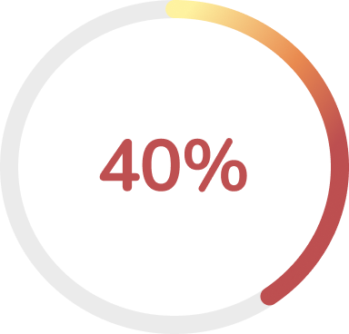
What is your opinion on an Augmented Reality feature that provides beauty product recommendations?
40% of participants believed that an Augmented Reality feature, that provides beauty product recommendations, would be beneficial for people who are just starting their skin and beauty journey.​
Notes:
We found out that 40% of participants believed that an Augmented Reality feature, that provides beauty product recommendations,
would be beneficial for people who are just starting their skincare and beauty journey.​
Participants stated that this Augmented Reality feature could potentially:
Reduces choice paralysis ​
Provide an affordable starting point​ when looking for skincare and beauty products

Slide 29
“I think it’s a good idea. Technology is a part of our lives.”
Notes:
This is a quote from one of our participants. When answering the previous question, the participant stated “ I think it is a good idea. Technology is a part of our lives.”

Slide 30
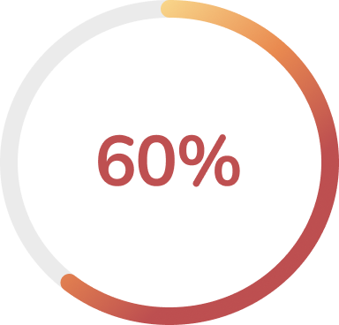
When ordering beauty products online what are some things you take into consideration?
60% of participants considered their sensitive skin when ordering beauty products online.
Notes:
60% of participants considered their sensitive skin when ordering beauty products online.
Learning that 60% of our interviewees had sensitive skin began to spark ideas regarding how we could
Possibly help them find the best products for them.

Slide 31
“I have sensitive skin, so I have to consider if the product will break me out.”
Notes:
When answering the previous question, one of our participants stated “ I have sensitive skin, so I have to consider if the product will break me out”

Slide 32
When ordering beauty products online what are some things you take into consideration?
40% of participants reported having eczema.
Notes:
40% of participants reported having eczema.
This was important insight because we started to understand that a good amount of our participants had skin issues that they needed to keep in mind while shopping for beauty products

Slide 33
“I have dry skin, so I have to find products that help with that and eczema.”
Notes:
“I have dry skin, so I have to find products that help with that and eczema.

Slide 34
What are your thoughts about shopping in a Virtual Reality beauty store?
60% of participants believed that a Virtual Reality shopping experience will make purchasing beauty products more accessible.​
Notes:
60% of participants believed that a Virtual Reality shopping experience will make purchasing beauty products more accessible.
The reasoning for this was that:
- A person might not be close to any stores that sell the beauty products they need.
- Social distancing
- Physically unable to go to stores

Slide 35
“This could make shopping accessible to people that might be physically unable to go to stores.”
Notes:
This could make shopping accessible to people that might be physically unable to go to stores.

Slide 36
(Cont.) What are your thoughts about shopping in a Virtual Reality beauty store?
100% of participants were interested in trying a Virtual Reality beauty shopping experience.​
Notes:
100% of participants were interested in trying a Virtual Reality beauty shopping experience.​
This information proves that people want to try one of our key services…The Virtual Reality beauty store

Slide 37
“I would like to try it. When I think about the idea, I think about a VR world.”
Notes:
“I would like to try it. When I think about the idea, I think about avatars a VR world.”

Slide 38
Key Takeaways
100% of participants were interested in trying a Virtual Reality beauty shopping experience.​
Implement an Augmented Reality feature that analyzes user's skin and offers them product recommendations.
Notes:
- The first key takeaway from our interviews was that all participants were interested in trying a Virtual reality beauty shopping experience.
- The second takeaway gave us another way to possibly implement augmented reality.
Prior to these interviews we only thought about utilizing Augmented Reality for makeup selection.
However, after gaining insight on our target user’s and learning about some of their skin issues such as eczema
And dry skin we realize that there might be a need for an AR feature that analyzes our user's skin.

Slide 39
Quantitative Research

Slide 40
Hypothesis
People who purchase beauty products are interested in a Virtual Reality beauty product shopping experience​

Slide 41
Null Hypothesis
People who purchase beauty products are not interested in a Virtual Reality beauty product shopping experience​.

Slide 42
Method
We will create a survey to see if our hypothesis is valid. The survey will be made on Google forms and be live from 10/21 to 10/23. Each team member will send out the survey through various social media outlets.

Slide 43
Screener Questions
Have you heard of Virtual Reality (VR)?​
Yes​
No​
Have you heard of Augmented Reality (AR)?​
Yes​
No​
Do you buy beauty products online? (Beauty products include skincare and makeup)​
Yes​
No​
I don’t buy beauty products

Slide 44
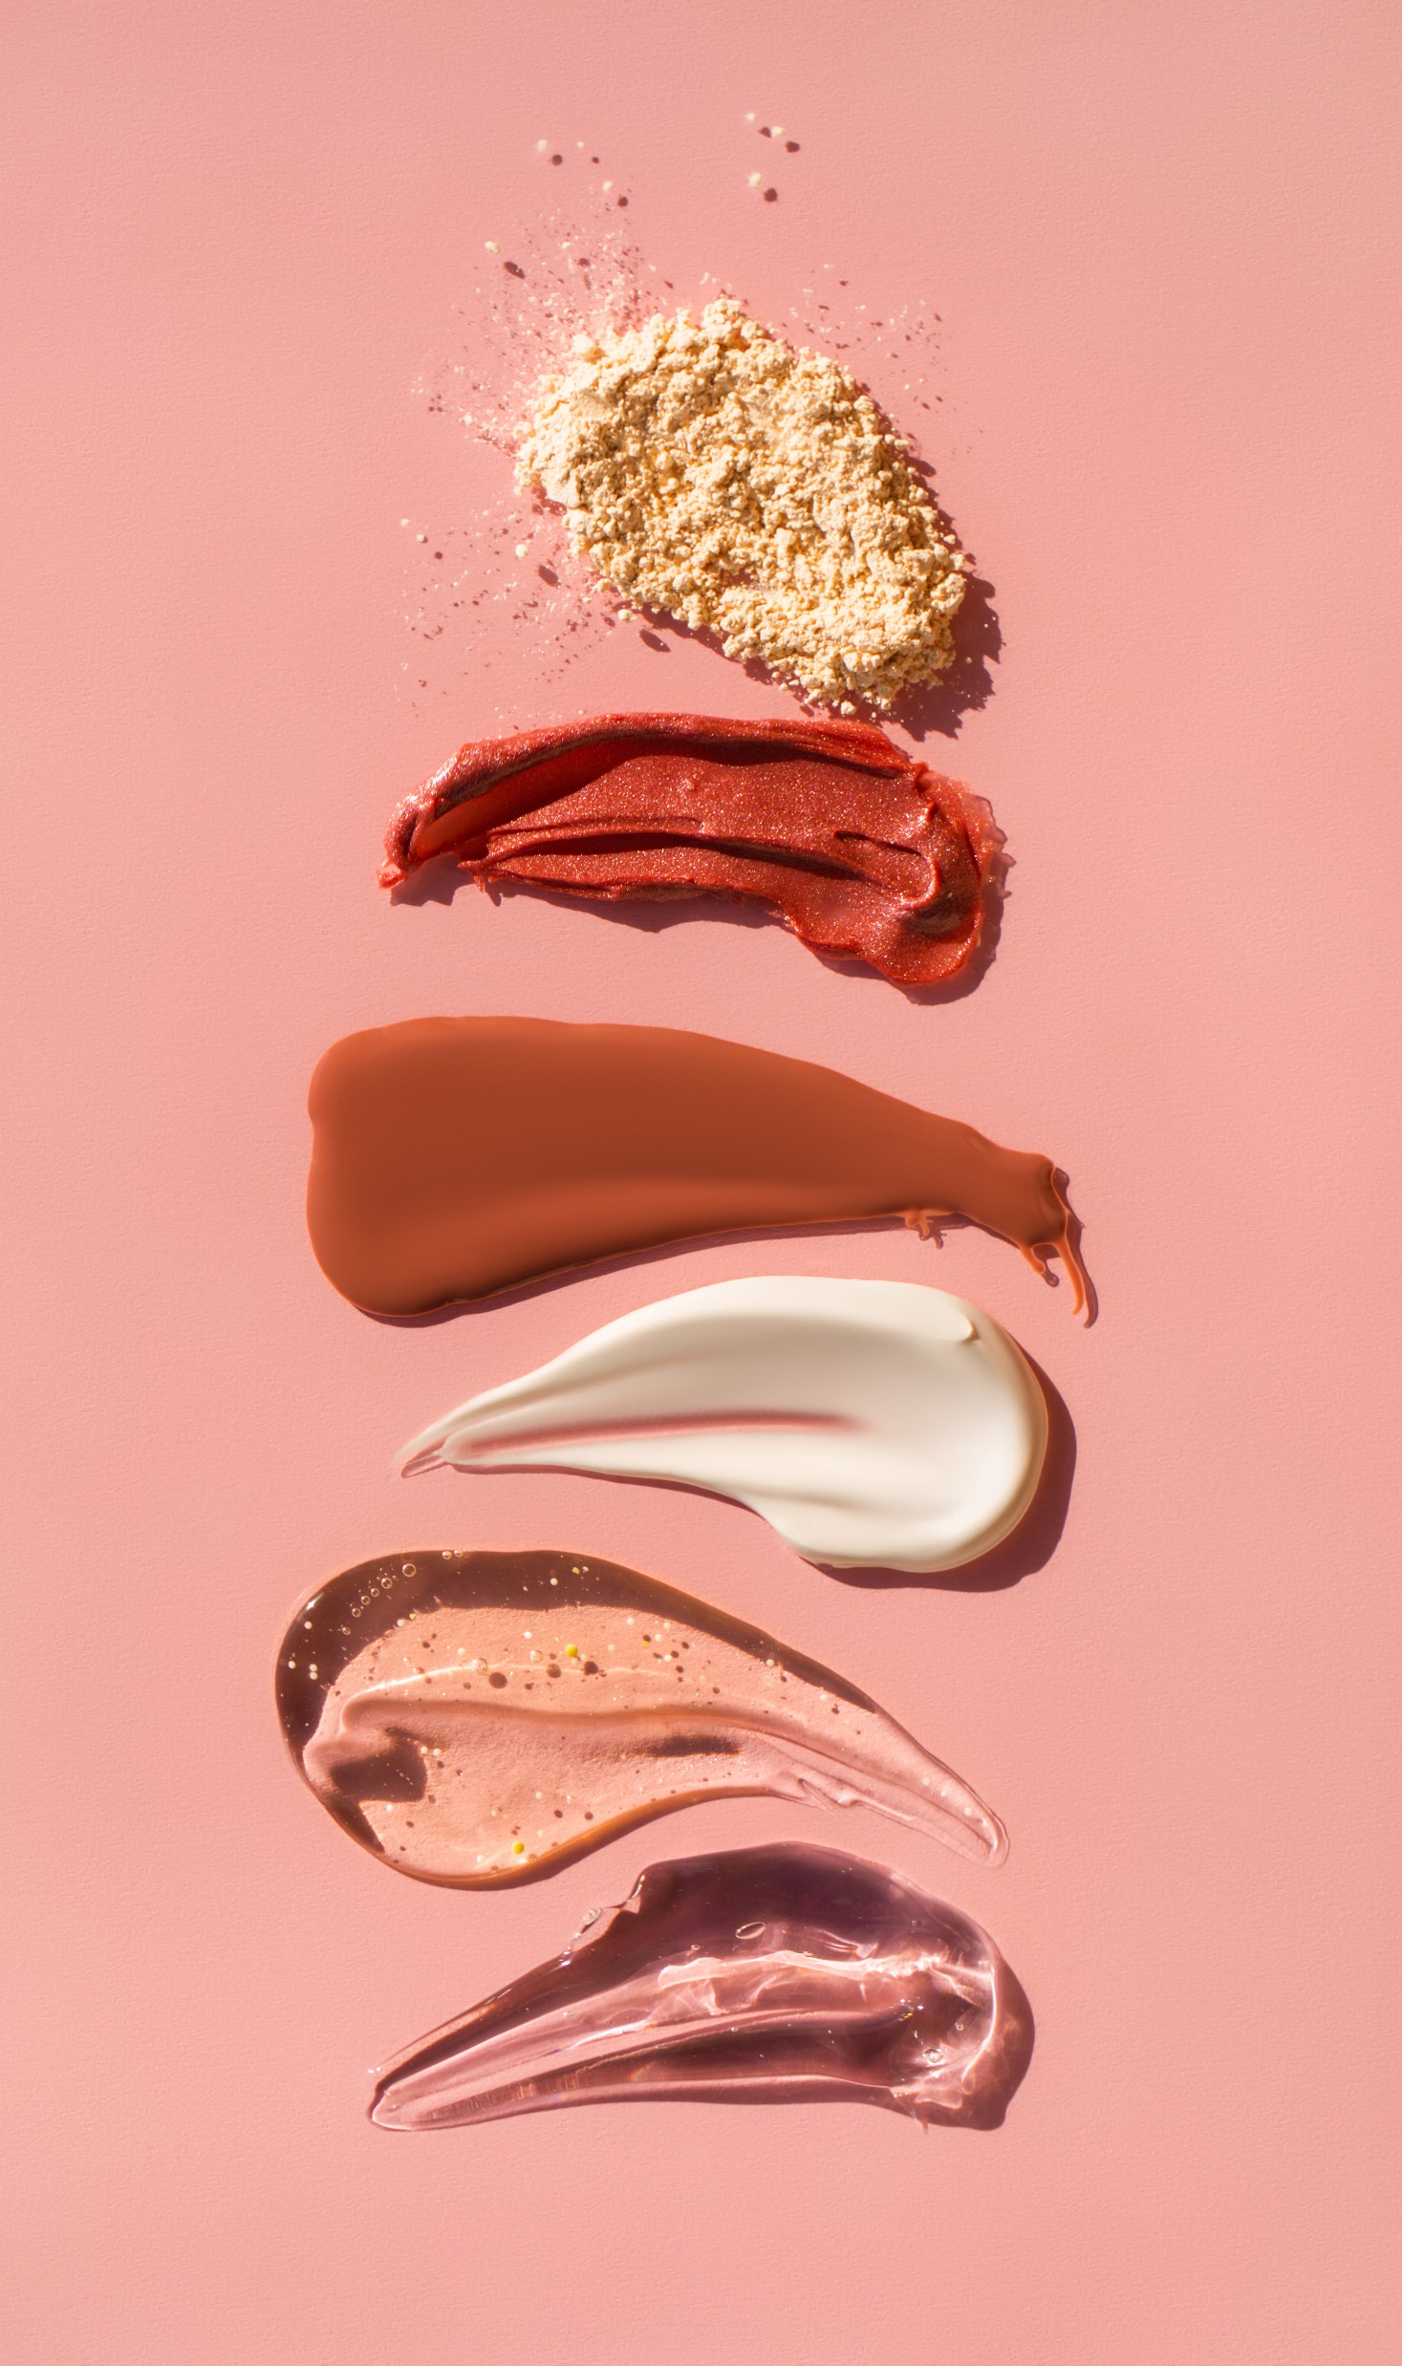
Core Questions
How interested are you in Virtual Reality (VR)?​
Very Interested​
Interested​
Somewhat Interested​
Not Interested​
I’m not sure​
How interested are you in Augmented Reality (AR)?​
Very Interested​
Interested​
Somewhat Interested​
Not Interested​
I’m not sure

Slide 45
Core Questions - Continued
How interested would you be in trying a Virtual Reality (VR) beauty store experience? (Beauty store that simulates a physical shopping experience)​
Very Interested​
Interested​
Somewhat Interested​
Not Interested​
I’m not sure
How interested are you in trying an Augmented Reality (AR) feature that provides skincare product recommendations? (Virtual feature that assesses your skin type to recommend products customized for you)​
Very Interested​
Interested​
Somewhat Interested​
Not Interested​
I’m not sure

Slide 46
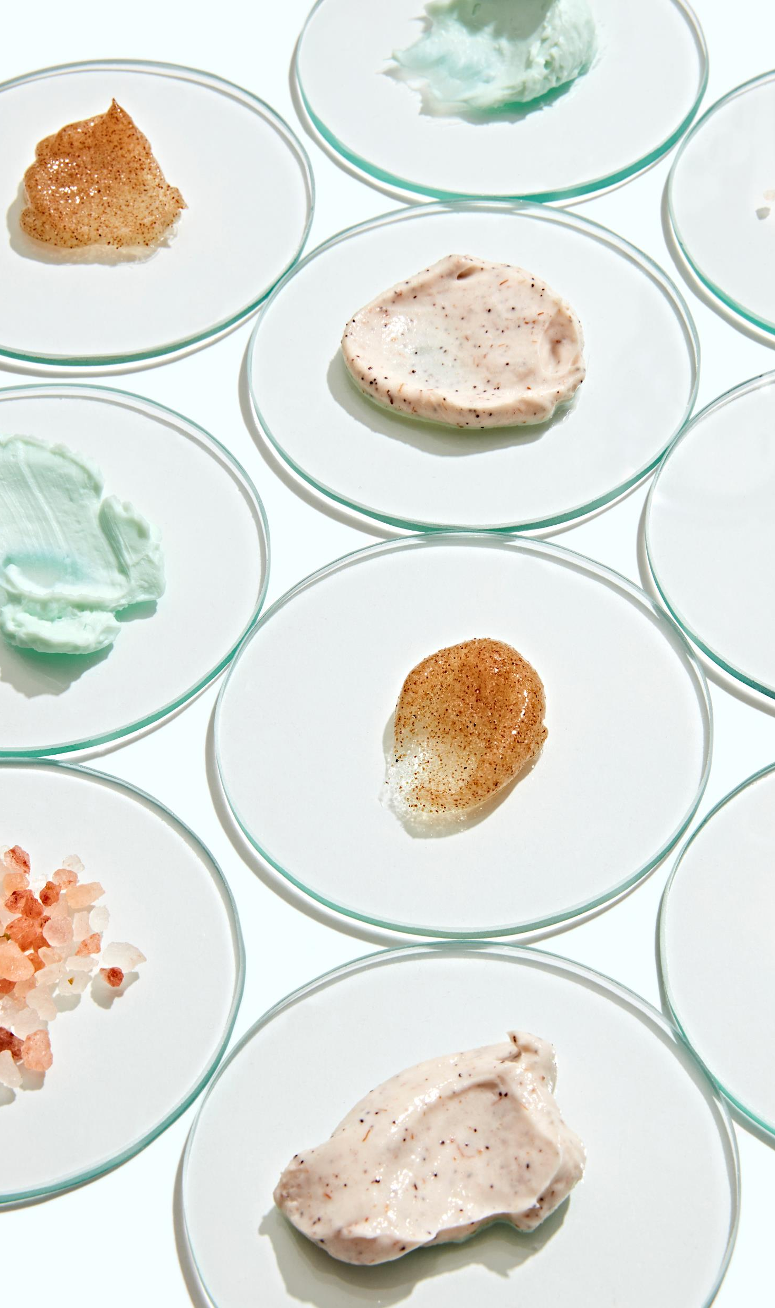
Core Questions - Continued
Do you have concerns about your skin that you consider when looking for beauty products? (Beauty products include skincare and makeup)​
___________________​
Would you be interested in a chat feature to interact with other customers in a Virtual Reality (VR) beauty store?​
Very Interested​
Interested​
Somewhat Interested​
Not Interested​
I’m not sure

Slide 47
While We Have You Here…
Have you experienced Virtual Reality (VR) before?​
Yes​
No​
Have you experienced Augmented Reality (AR) before?​
Yes​
No​
How often do you shop for beauty products online? (Beauty products include skincare and makeup)​
1-2 times a month​
2-5 times a month​
More than 5 times a month​
Other: ______________

Slide 48
While We Have You Here… Continued
How important is it for you to try on beauty products before buying them? (Beauty products include skincare and makeup)​
Very Important​
Important​
Somewhat Important​
Not Important​
I’m not sure​
Please explain your feelings about trying on beauty products before buying them. (Beauty products include skincare and makeup)​
___________________

Slide 49
Quantitative Research Results
Notes:
The following slides detail our quantitative research results

Slide 50
Participants
There were a total of 69 survey responses.​
25 participants passed the screener. The following results reflect their responses.
Notes:
- There were a total of 69 survey responses.​
- 25 participants passed the screener. The following results reflect their responses.

Slide 51
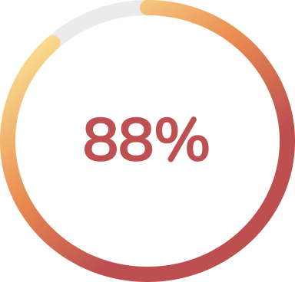
How interested are you in Virtual Reality (VR)?
88% of participants were interested in Virtual Reality.​
Notes:
For the first question we found out that 88% of participants were interested in Virtual Reality.​
This showed that there is an interest in Virtual Reality.

Slide 52
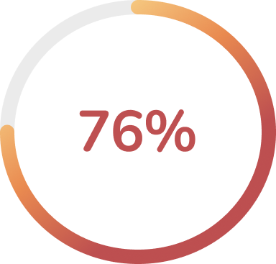
How interested are you in Augmented Reality (AR)?
76% of participants were interested in Augmented Reality. ​
Notes:
76% of participants were interested in Augmented Reality.
This proved That there is a large amount of interest in Augmented Reality.

Slide 53
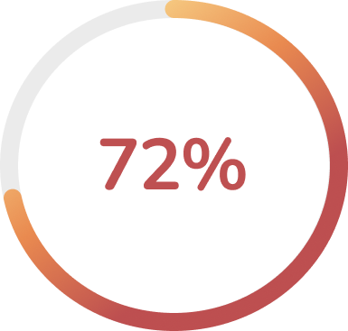
How interested would you be in trying a Virtual Reality (VR) beauty store experience? (Beauty store that simulates a physical shopping experience)
72% of participants were interested in trying a Virtual Reality beauty store shopping experience.​
Notes:
72% of participants were interested in trying a Virtual Reality beauty store shopping experience.​
This proved that most of our participants would want to try a Virtual Reality beauty store shopping
Experience.

Slide 54
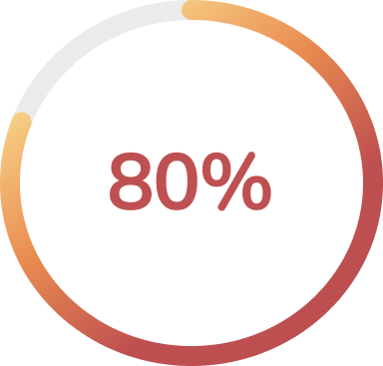
How interested are you in trying an Augmented Reality (AR) feature that provides skincare product recommendations? (Virtual feature that assesses your skin type to recommend products customized for you)
80% of participants were interested in trying an Augmented Reality feature that provides skincare product recommendations.​
Notes:
80% of participants were interested in trying an Augmented Reality feature that provides skincare product recommendations.​
This showed us that there is a substantial desire for this Augmented Reality feature.

Slide 55
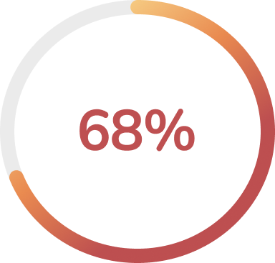
Have you experienced Virtual Reality (VR) before?
68% of participants had experienced Virtual Reality before.​
Notes:
68% of participants had experienced Virtual Reality before.​
So, the majority of the participants had experienced Virtual Reality.

Slide 56
Have you experienced Augmented Reality (AR) before?
40% of participants had experienced Augmented Reality before.​
Notes:
40% of participants had experienced Augmented Reality before.​
This was beneficial to know. Since most of our participants have not experienced Augmented Reality before
We want make sure that their first experience is pleasant, and we want to make sure that our Augmented
Reality features are easy to understand and easy to use.

Slide 57
How often do you shop for beauty products online? (Beauty products include skincare and makeup)
68% of participants stated that they shop for beauty products 1-2 times a month online.​
Notes:
68% of participants stated that they shop for beauty products 1-2 times a month online.​
Since we are an online beauty store, we want to make sure that our target group shops
Consistently online for beauty products.

Slide 58
Do you have concerns about your skin that you consider when looking for beauty products? (Beauty products include skincare and makeup)
“Prevent aging”​
“I have sensitive skin that is very oily.”​
“Dry, sensitive skin, fair skin”​
“I tend to look for products that don’t harm acne prone skin.”​
“Yes, mainly with shade matching.”​
“I have concerns with getting the right product for my skin type”​
“Rosacea and sensitive skin”
Notes:
This was a short response question. A few quotes that allowed us to understand our users more were:
“I tend to look for products that don’t harm acne prone skin.”​
“Prevent aging”
“I have concerns with getting the right product for my skin type”​
These words are our user’s pain points so this information allowed us to empathize even more with our users …helping us think of ways to solve their
various concerns.

Slide 59
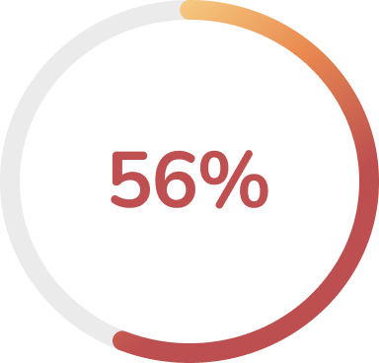
Would you be interested in a chat feature to interact with other customers in a Virtual Reality (VR) beauty store?
56% of participants were interested in a chat feature to interact with other customers in a Virtual Reality beauty store.​
Notes:
56% of participants were interested in a chat feature to interact with other customers in a Virtual Reality beauty store.​

Slide 60
How important is it for you to try on beauty products before buying them? (Beauty products include skincare and makeup)
88% of participants believed that trying on beauty products before purchasing them is important.​
Notes:
88% of participants believed that trying on beauty products before purchasing them is important.​
This gave us the data we needed…. to justify our Augmented Reality feature that allows users to try on beauty products more specifically makeup products.

Slide 61
Please explain your feelings about trying on beauty products before buying them. (Beauty products include skincare and makeup)
“It is very important for me to be able to sample cosmetics and fragrances. In terms of skincare cleansers and lotions, I would like to know that a product will not irritate or dry out my skin. The scent of skincare products is also very important to me.”​
“You should try beauty products before you buy them because it will allow you to know how it will look.”​
“I always get nervous buying makeup like concealer and foundation online.I tend to do my research. Same with skin care, I tend to do my research.”
Notes:
This was another short response question and I want to read the third bullet…
“I always get nervous buying makeup like concealer and foundation online[…]I tend to do my research. Same with skin care, I tend to do my research.”
Once again, this quote puts us in the shoes of our users. this quote sparked more ideation and brainstorming… for example, what if Omnis’ skin analysis
Feature does the research for our customers. Think of the time that they’ll save. Think of the emotions that could be alleviated.

Slide 62
Competitive Analysis

Slide 63
Competitive Analysis
The focus of our competitive analysis is to assess the problems our competitors are solving using AR and VR technology. Some key elements we want to learn more about include:​
How AR and VR technology is incorporated into online shopping​
The impact VR and AR technology had on the consumer
Notes:
Our focus while doing our competitive analysis is finding how our competitors use AR and VR technology and what problems are being solved by using it. Using Morville’s honeycomb, one of the things that we want to learn is the usefulness aspect of it. Are both the VR and AR technology useful in enhancing the user’s online shopping experience? How does it impact them?

Slide 64
Competitive Analysis (Cont.)
Is it easy for the user to locate the AR and VR features available on each competitor's website and app?​
Future plans to expand use of AR and VR technology?
Understanding how our competitors use AR and VR technology will help us provide a beauty store shopping experience that others wouldn’t find elsewhere.
Notes:
Going back to the honeycomb, we also want to understand how findable the VR and AR technology are. Is it easy to find or is it so hard to find that users aren’t even aware that it’s there? Gaining a better understanding of our competitors would help us build out a unique beauty store shopping experience that users wouldn’t find in other beauty brands.

Slide 65
Potential Competitors
Ulta Beauty
Sephora
Clinique
Charlotte Tilbury
It Cosmetics
Notes:
Ulta and Sephora are our direct competitors since they are beauty retail companies. Clinique, Charlotte Tilbury, and It Cosmetics are our indirect competitors since they still provide users with beauty products from their own brand and operates in a similar way that Omnis, Ulta, and Sephora does. What makes each of them a viable candidate for our competitor analysis is that they all use VR and AR technology in a way that would enhance users’ online shopping experience.

Slide 66
Direct competitor
SPARKED Virtual Experience – VR online store that showcases four specialty beauty brands​
Notes:
Ulta, our first direct competitor, has come close to what we envisioned the VR aspect of our service would look like. Their SPARKED Virtual Experience provides a simulation of a physical store and has aspects of what we wanted in our service, such as the ability to find information about each product and being able to add it into your bag from the metaverse.

Slide 67
GLAMlab Virtual Try-On – AR Feature
Product Try-On – Lets users try on different makeup products through facial recognition
Foundation Shade Finder – Helps users find their foundation shade​
Skin Analysis – Gives product recommendations based on skin type and issues​
Notes:
Ulta’s AR feature can help users try on products virtually. Their AR feature is that it can also find the right foundation shade for you by assessing your skin tone and undertone. The Glamlab virtual try on also has a skin analysis feature that uses facial recognition and a little questionnaire asking about your skin type and concerns to make a list of product recommendations tailored for each user.

Slide 68
Direct competitor
Sephora’s Virtual Artist – mobile app AR feature that uses facial recognition
Provides step-by-step makeup tutorials
SEPHORiA: House of Beauty – virtual beauty event
Notes:
Sephora have an AR feature that lets users try on different makeup products and provides step-by-step makeup tutorials that are personalized to each user’s face. SEPHORiA: House of beauty, their annual virtual beauty event, is a place where users can immerse themselves in a beauty VR environment.

Slide 69
Indirect competitor​
Clinique iD pop-up shop – combined a traditional beauty store experience with VR
Notes:
Clinique is our third competitor and a beauty brand company that recently started using VR. When they opened up a pop up shop for their Clinique iD products, they also used VR to promote these products by immersing users in a VR world.

Slide 70
Indirect competitor
AR webpage - Charlotte’s Magic Mirror Makeup Online Try On​
VR webpage - Charlotte Tilbury's My Pillow Talk Party
Notes:
Charlotte Tilbury is our next indirect competitor. Their VR also came the closest to what we wanted as it also included the same things that Ulta’s VR Experience had. Their AR webpage functions similarly to how other competitors’ work, where people can try on different products.

Slide 71
Indirect competitor
IT Cosmetics Derma Scan - AR technology helps the user personalize a skincare routine
IT Cosmetics Virtual Try-On - allows customers to virtually try on makeup using facial recognition
Notes:
Much like how Ulta’s GlamLAB works, IT cosmetic’s derma scan actually provides product recommendations based on a questionnaire and facial scan. IT cosmetics also has a virtual try-on.. Which is self-explanatory. I won’t get into the details, but I’m sure you guys know what it does.

Slide 72
SWOT Analysis
We decided to use the SWOT Analysis to gather and track information about our competitors. ​
This will enable us to see the strengths, weaknesses, opportunities and threats present in each competitor and help us determine any missing pieces and our next steps in building our service.
Notes:
Each team member had to do a SWOT Analysis of each of our competitors to gain a better understanding of them. We can possibly implement features that could be working well for them in their strengths and look for opportunities that we can use from their weaknesses. We can also learn about what is currently threatening them and be aware of what could also affect Omnis as well.

Slide 73
Heuristic Evaluation
We used usability heuristics to understand and evaluate the usability of our competitor's websites and apps. ​
This helped us identify usability issues, discover why those issues exist, and find solutions. This will improve the user’s satisfaction and experience and raise the chances of our service’s success.
Notes:
Each team member had to do a heuristic evaluation of each of our competitor to learn more about how they apply each of the ten usability heuristics on their website and app, if applicable. Not only does it help us identify usability issues that we can make solutions for, but we can also implement usability features that seem to be working for them. This way, we can create a better experience for the user when designing our service.

Slide 74
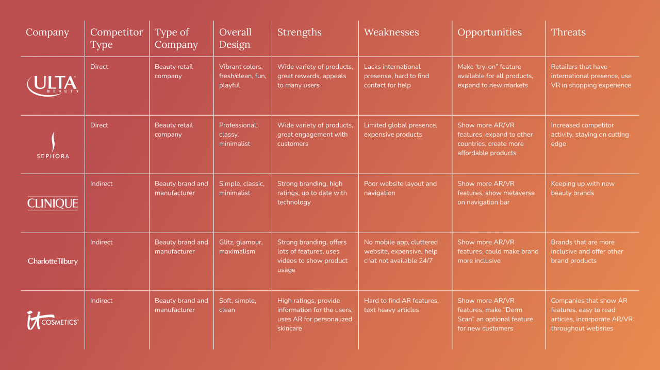
Notes:
In our strengths, we have found that some companies provide a wide variety of beauty products to cater to everyone, which is something that we’d like to implement when designing our service. For their weaknesses, we have found that the findability aspect of Morville’s honeycomb is not present, with poor website navigation and how hard it is to find the AR features. We have used that as an opportunity to create a simple way that users can access our products.

Slide 75
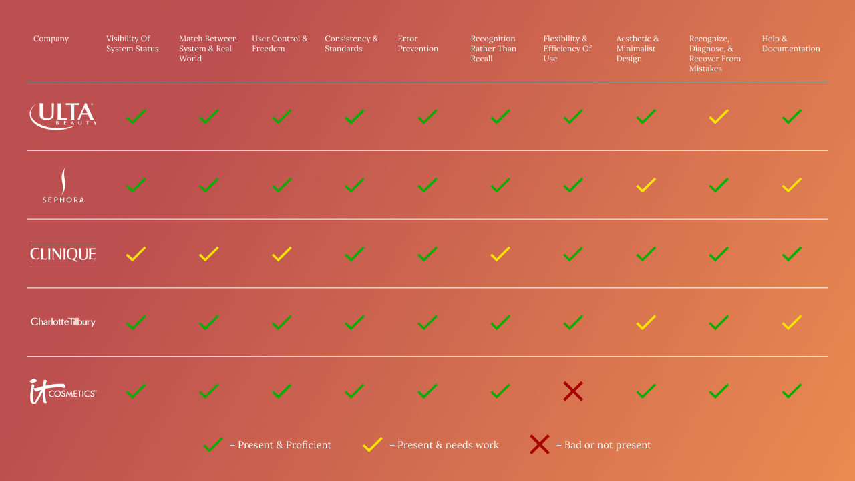
Notes:
You would think that major companies would have all ten of Norman’s Usability Heuristics, but no one is perfect. After each team member assessed each aspect of the usability heuristics, we have found that although it may be present in most companies, there are some issues that could use some improvement.

Slide 76
Conclusion of Research
In our research, we found that there is an interest in Omnis’ Virtual Reality beauty store shopping experience. The data collected will be used to craft a user persona which will help us build the ideal service. ​
Notes:
Overall, our research indicated that users are interested in trying out a Virtual Reality beauty store shopping experience. We have also found that we also need a skin analysis feature for our augmented reality service. Using our competitive analysis, we have gained some knowledge on not only how to build our services, but our website as well. The data we have collected throughout our research will be used to then create a user persona to look back to when building our service.

Slide 77
Priya’s Story
Notes:
As a result of our research, we were able to dig further in the Emphazise stage of our Design thinkiing

Slide 80
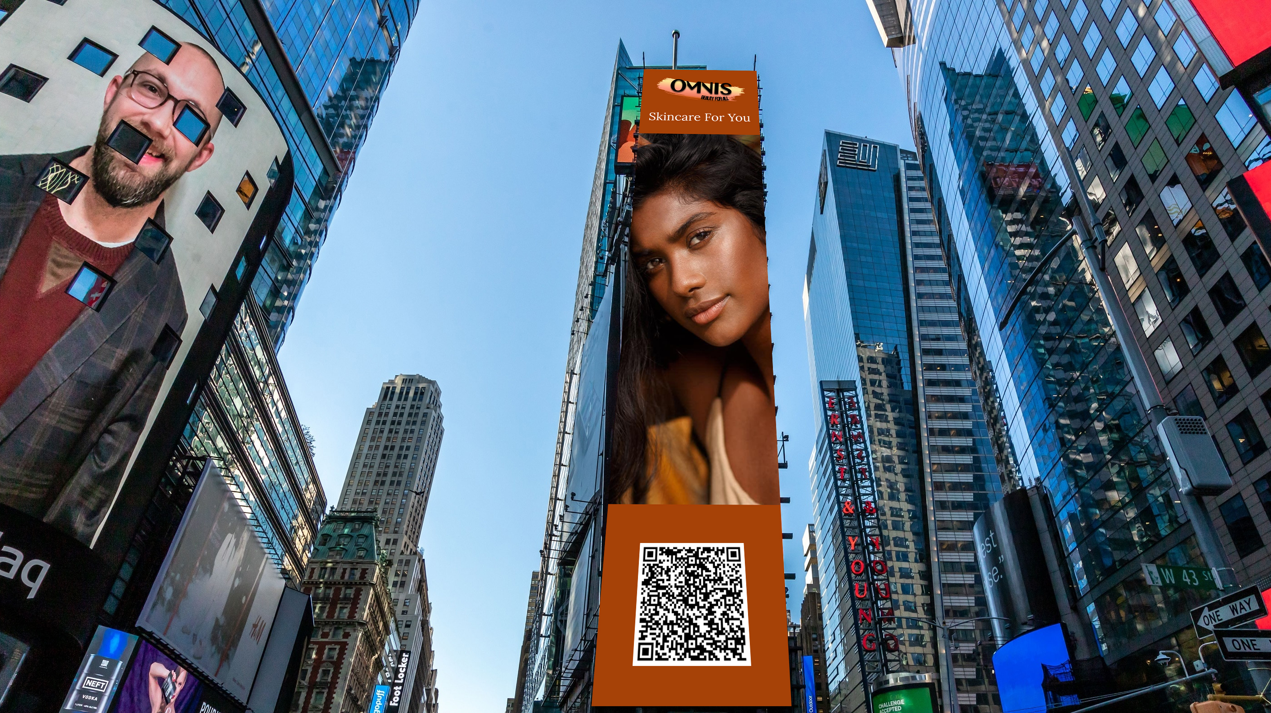

Slide 82
Designing The Omnisverse

Slide 83
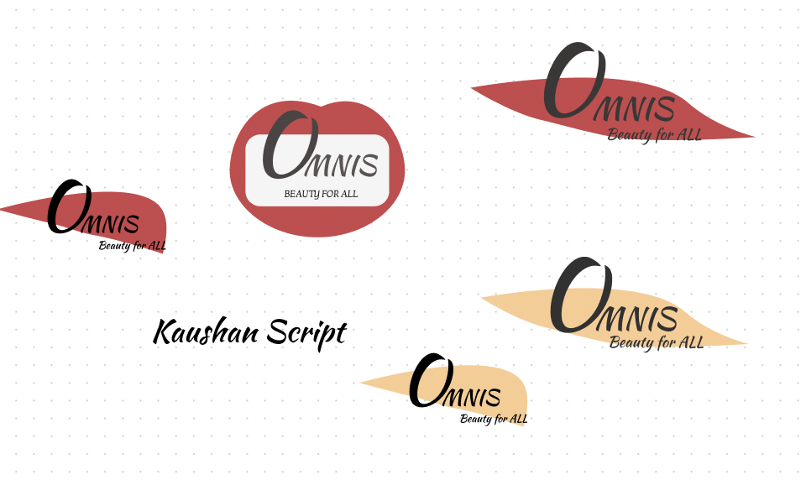
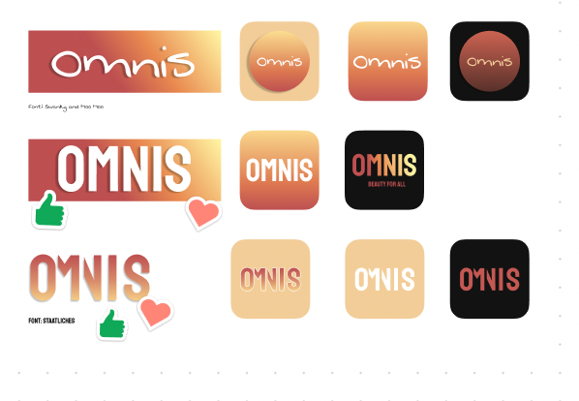
Logo Ideation
Notes:
We stared with the ideas in the top left but we felt that these colors and typography had no connection to our mission and that it creates a high-end feel to our product with was did not match the ethos of our brand. Since logo ideation is an iterative process, we went back and forth until we cam up with our final design which is in the botton right corner.

Slide 84
Omnis Logo
Notes:
Omnis is latin for all and we decide to use this word because we wanted to reiterate the theme of inclusivity and we wanted our users to understand that this product id for all people
For the text, we wanted to use a font the felt open and inclusive, playful but professional.
Omnis is a masteje level beauty brand. There are 3 levels, which are high end, masteje which is mid level and drug store level So we wanted our logo to maintain that mid-level.
We use the Gestalt Principle of Closure on the M and N. The clourse principle creates the illusion of seeing an a complete image with an incomplete one.
We added our slogan in the logo which is "Beauty for All" to empahsize inclusivity and representation
And the background is a makeup swatch with our colors in an ombre gradient. Our colors symbolize, openess, inclusivity, playfulness

Slide 85
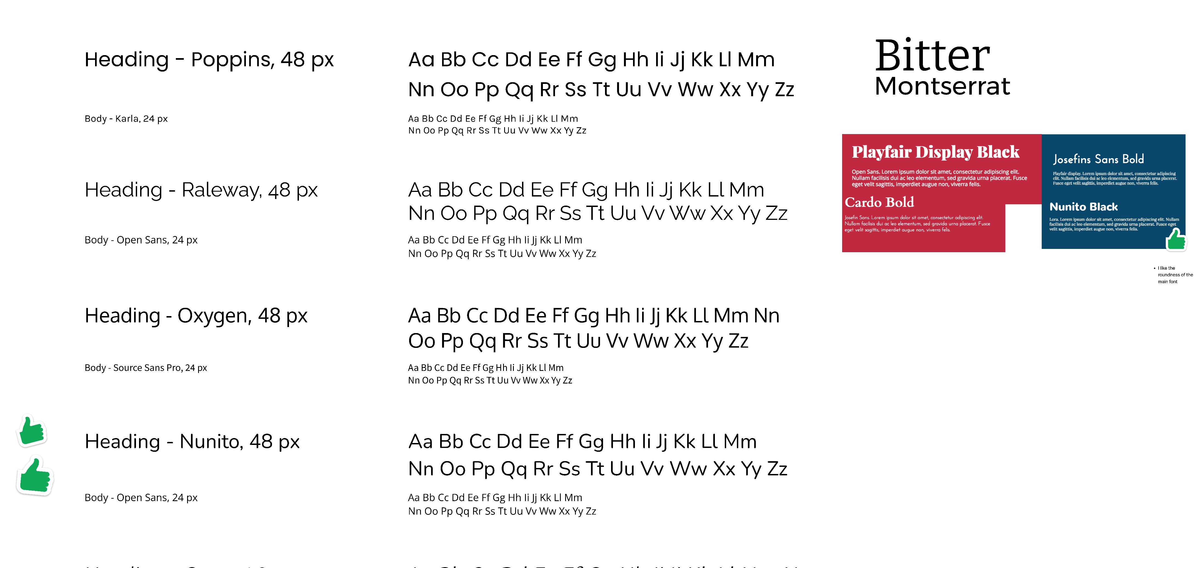
Notes:
We wanted to go for fonts that conveyed a modern, clean look. Each font was carefully picked not to look too elegant like the designer brands that you guys know or too playful like drugstore brands. We decided that Nunito would show that vibe we wanted to convey. After deciding on Nunito, we then proceeded to look for a font that would go well with it, and found Lora, a serif font.

Slide 86
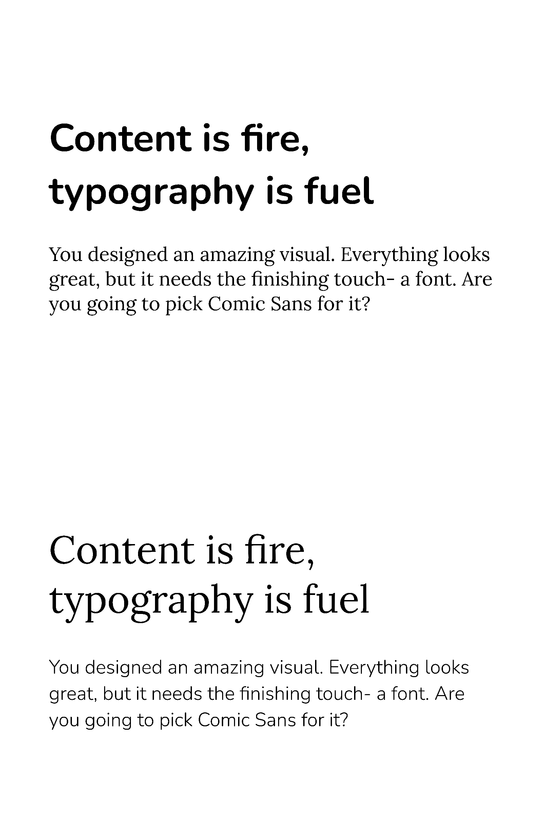
Notes:
After coming across research that people read sans serif type styles nearly twice as fast as serif online, we decided to swap it and use Nunito as our body and subheader and Lora as our header.

Slide 87
Notes:
The design behind each part of the style guide was already explained except for the slogan and color palette, so I will focus on those. For our slogan, we decided to go with Beauty for All since it basically encapsulates what our company stands for. We decided to build our palette around the color yellow. Yellow does an amazing job of representing inclusivity because it radiates energy, warmth, positivity, and optimism. Our company caters to a diverse audience, and we wanted our color palette to reflect that.

Slide 88
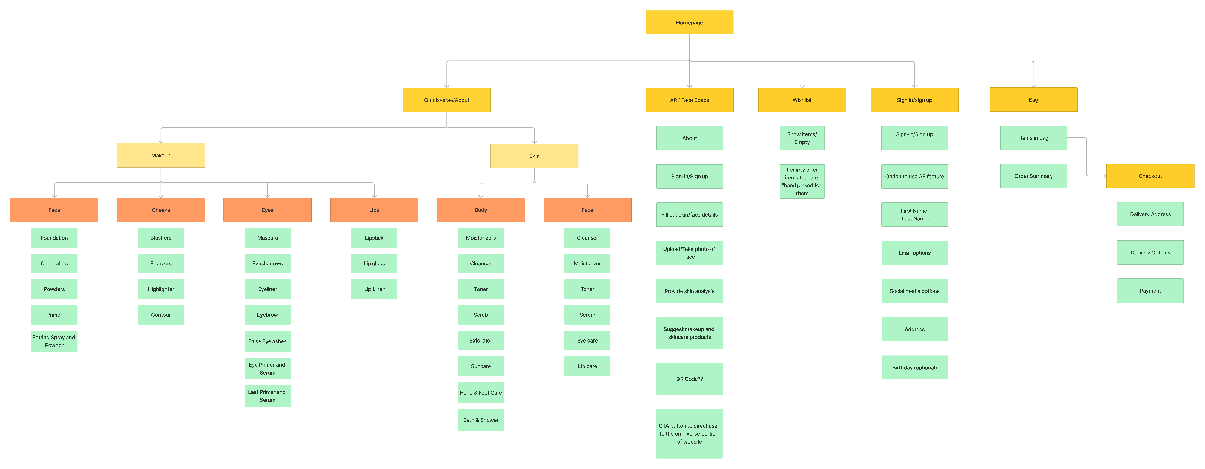
Notes:
Our information architecture was simple, with the main navigation buttons consisting of both of our services, a wishlist, sign up/login, and bag. Utilizing Jakob’s law, we designed our wishlist, sign up/login, and bag the same way that our competitors and other beauty brand companies did. As for Omnisverse, we decided to split everything into two main categories: makeup and skin. We then went on to split it into different categories that pertain to each feature of your face and body.

Slide 89
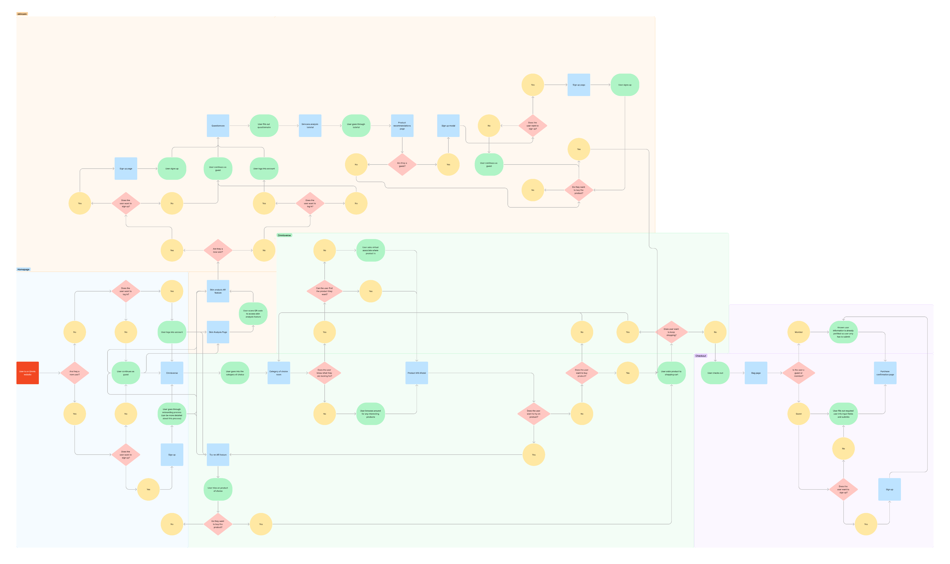
Notes:
For our user flow, we recreated the user flow of how someone would navigate through our website and services. We split it into four sections: the homepage, the skincare analysis app, omnisverse, and checkout process. Users start in the homepage then have the choice to go to omnisverse or skincare analysis page. Either way, they converge into the checkout process section where users can then buy their products.

Slide 90
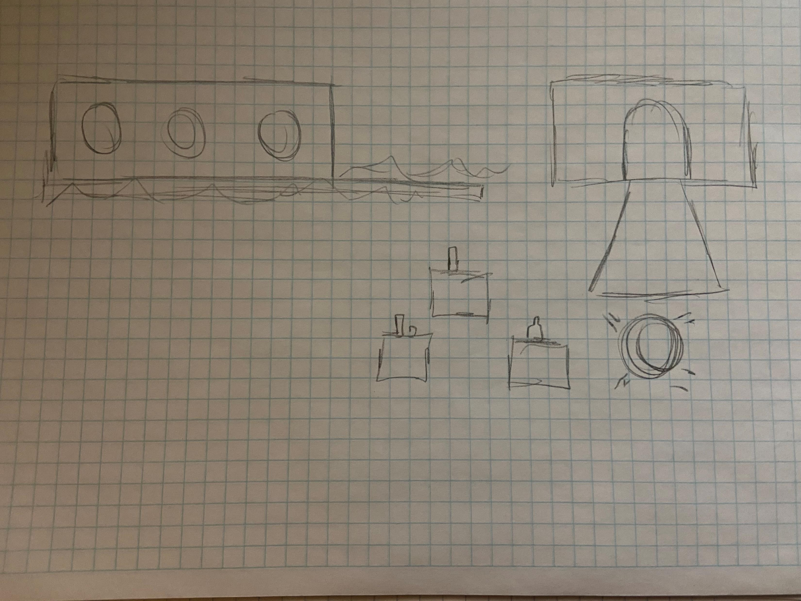
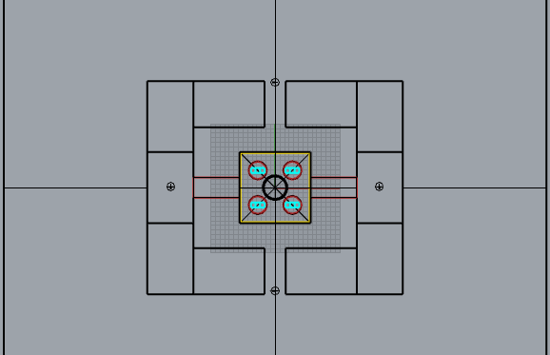
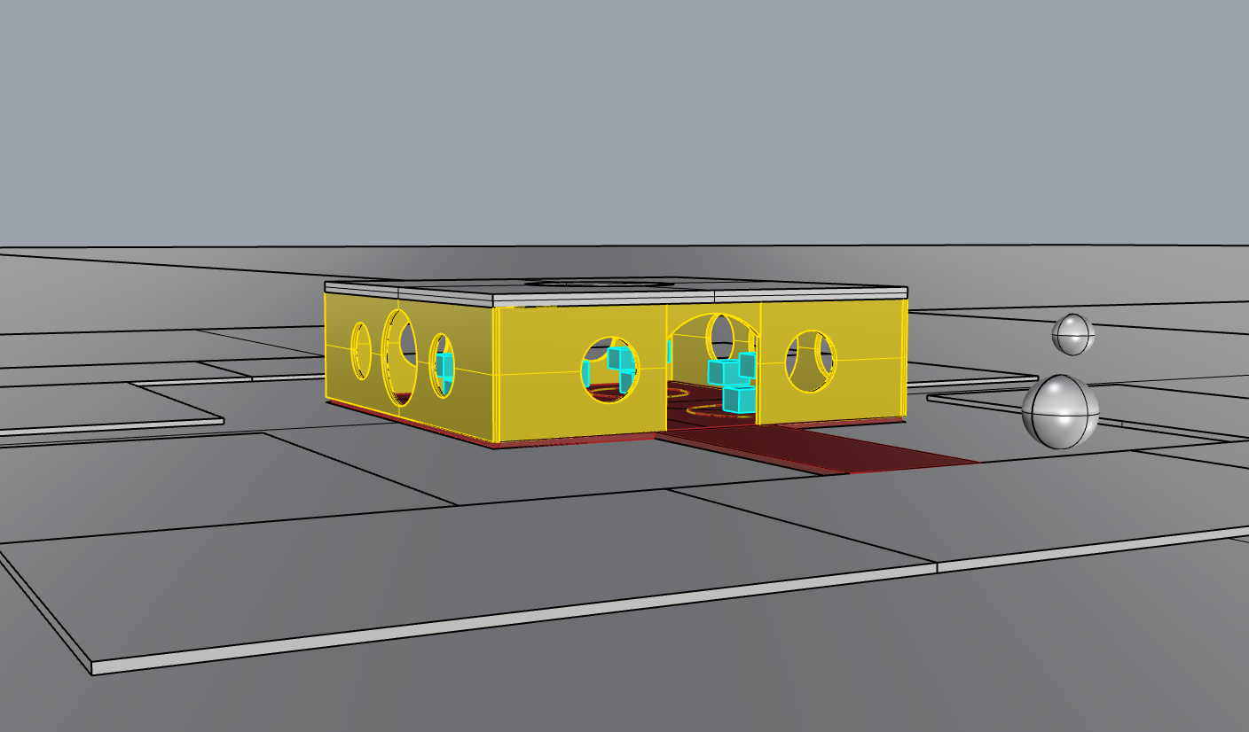
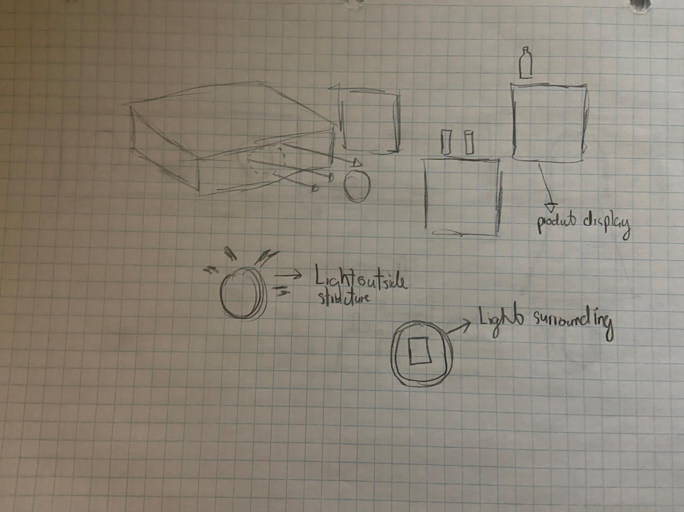
Notes:
So now we are getting into designing The Virtual Reality space. More specifically designing the 3d space for our make up products.
We started off by sketching how we wanted the building to look. We decided to go with a standard square floor plan. We Also decided to use
Display stands to showcase our products
We wanted to add circle openings to allow our virtual light source to enter the space in efficient and captivating ways.
After this, we built the 3D model and rendered it.

Slide 91
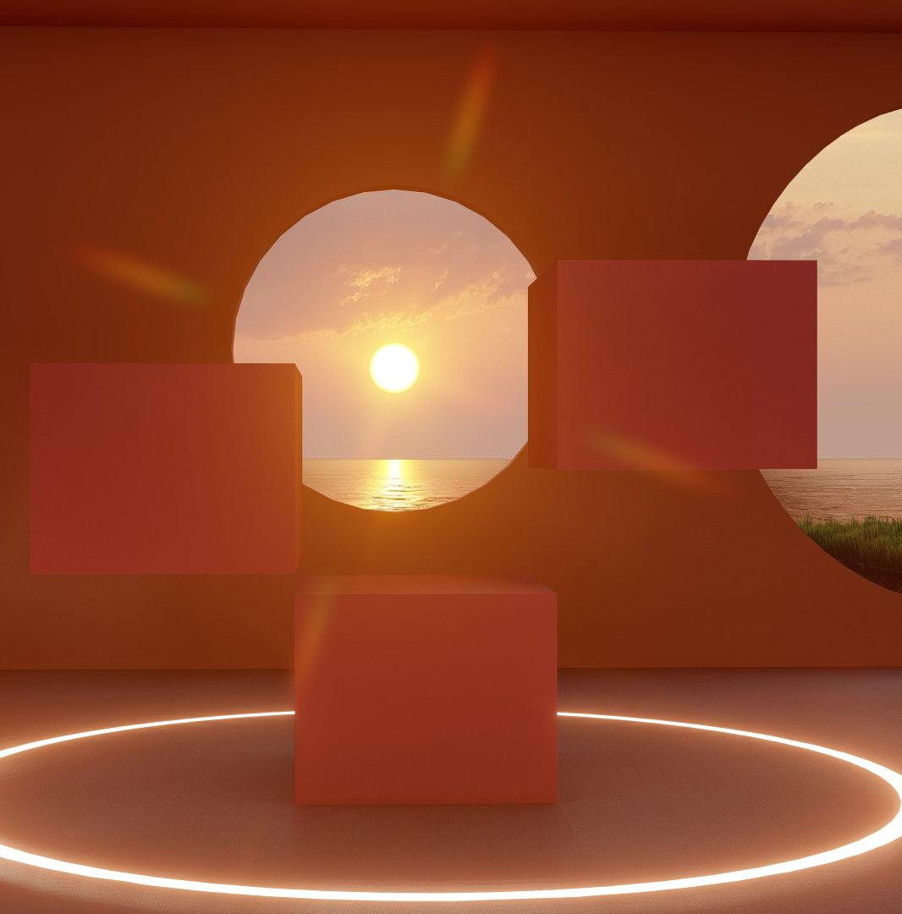
Notes:
These are rendered images of our Virtual reality makeup space. We decided to go with a dreamscape architectural aesthetic because
We wanted to provide our customers with a unique Virtual reality shopping experience.
The left image shows the final render of our display stands. It also shows how our structures circular openings allow light to enter.
The second image shows the entrance to our Virtual Reality space..
All of our design choices for the 3d space were meant to create a warm and welcoming environment

Slide 92
Notes:
This video showcases our 3d makeup space
Our users will have two ways to navigate our Virtual Reality space.
They can use their mouse and keyboard to walk and shop.
Or, if they don’t have a strong enough PC they will be able to use navigations buttons on our
website to shop. which we will talk more about when we discuss our prototype.

Slide 93
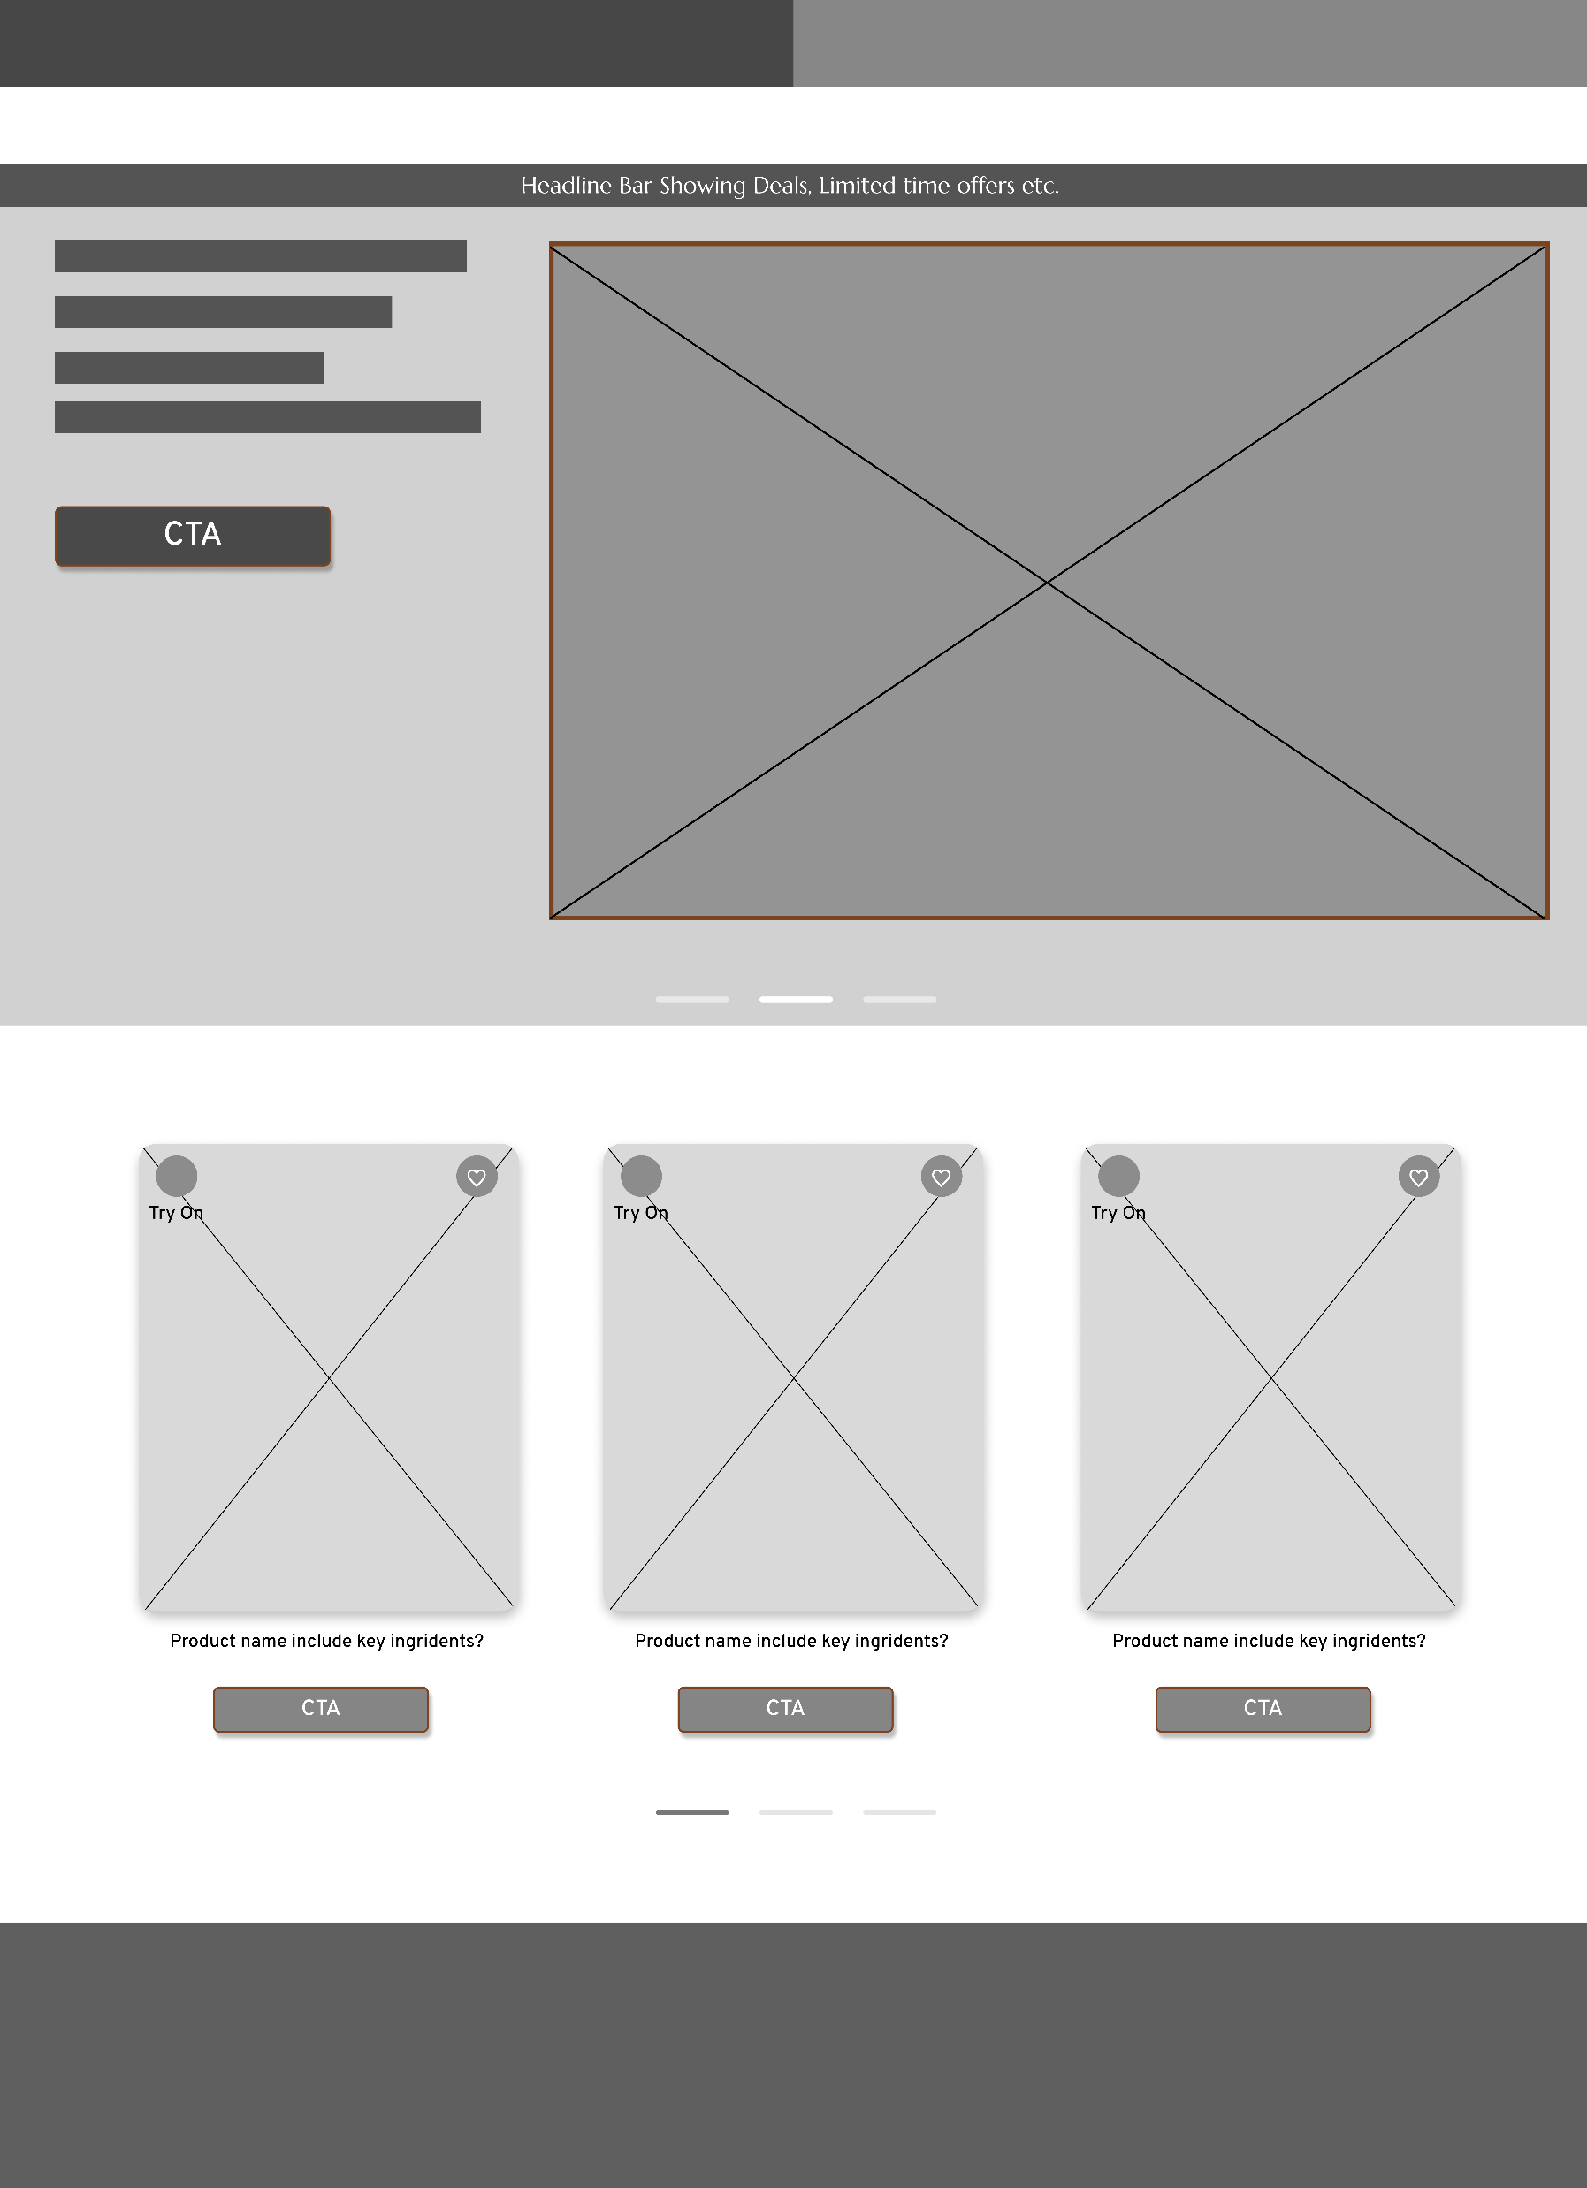
Notes:
So before designing the website we focused on wireframing our ideas, Here are a couple ideas we had for our Homepage. We all agreed to we wanted a carousal

Slide 94
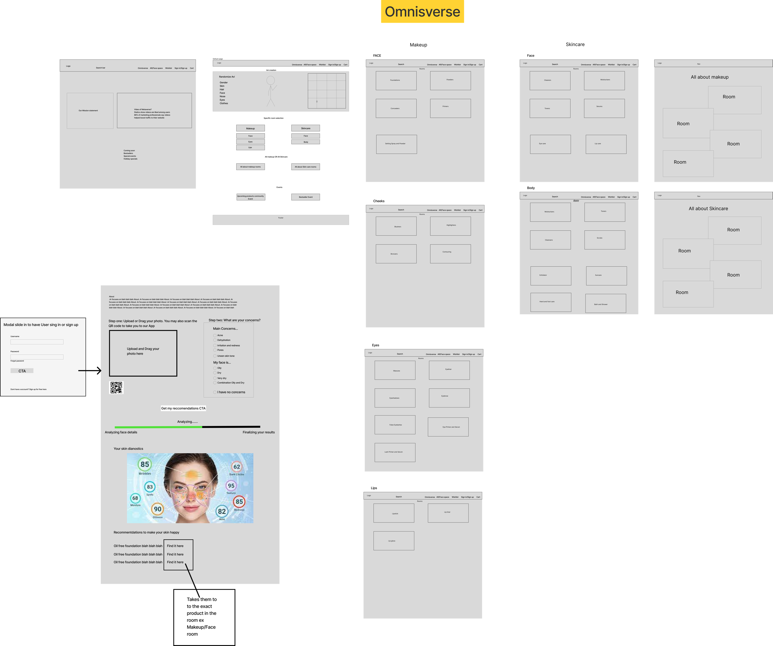
Notes:
This was our idea for the skin analysis to create an avatar to shop in the Omnisverse but we ended up scaping the idea of character creation as we decided users just needed convenience to jump right in to shop

Slide 95
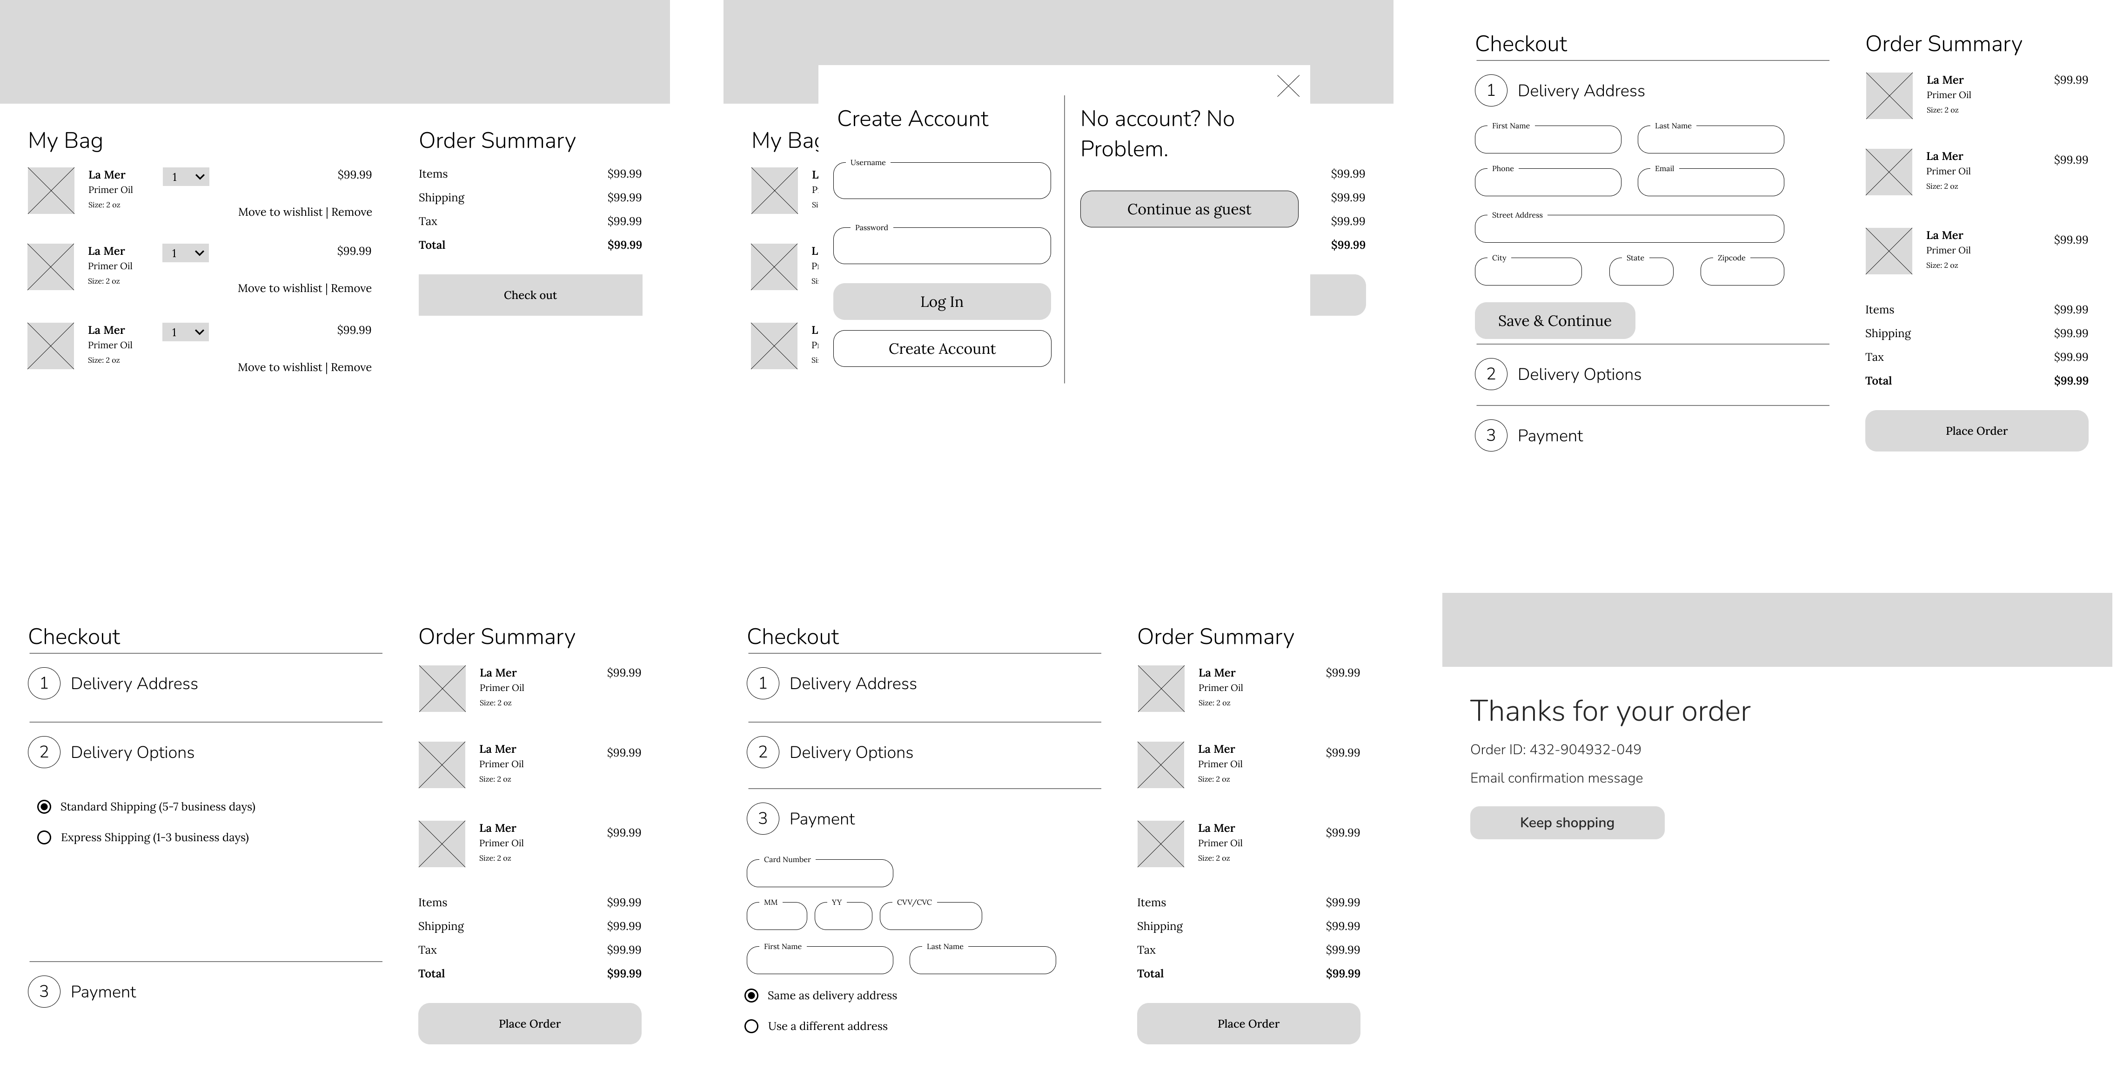
Notes:
Here is our checkout process wireframes. Because of Jacobs law we wanted out checkout process similar to others

Slide 96
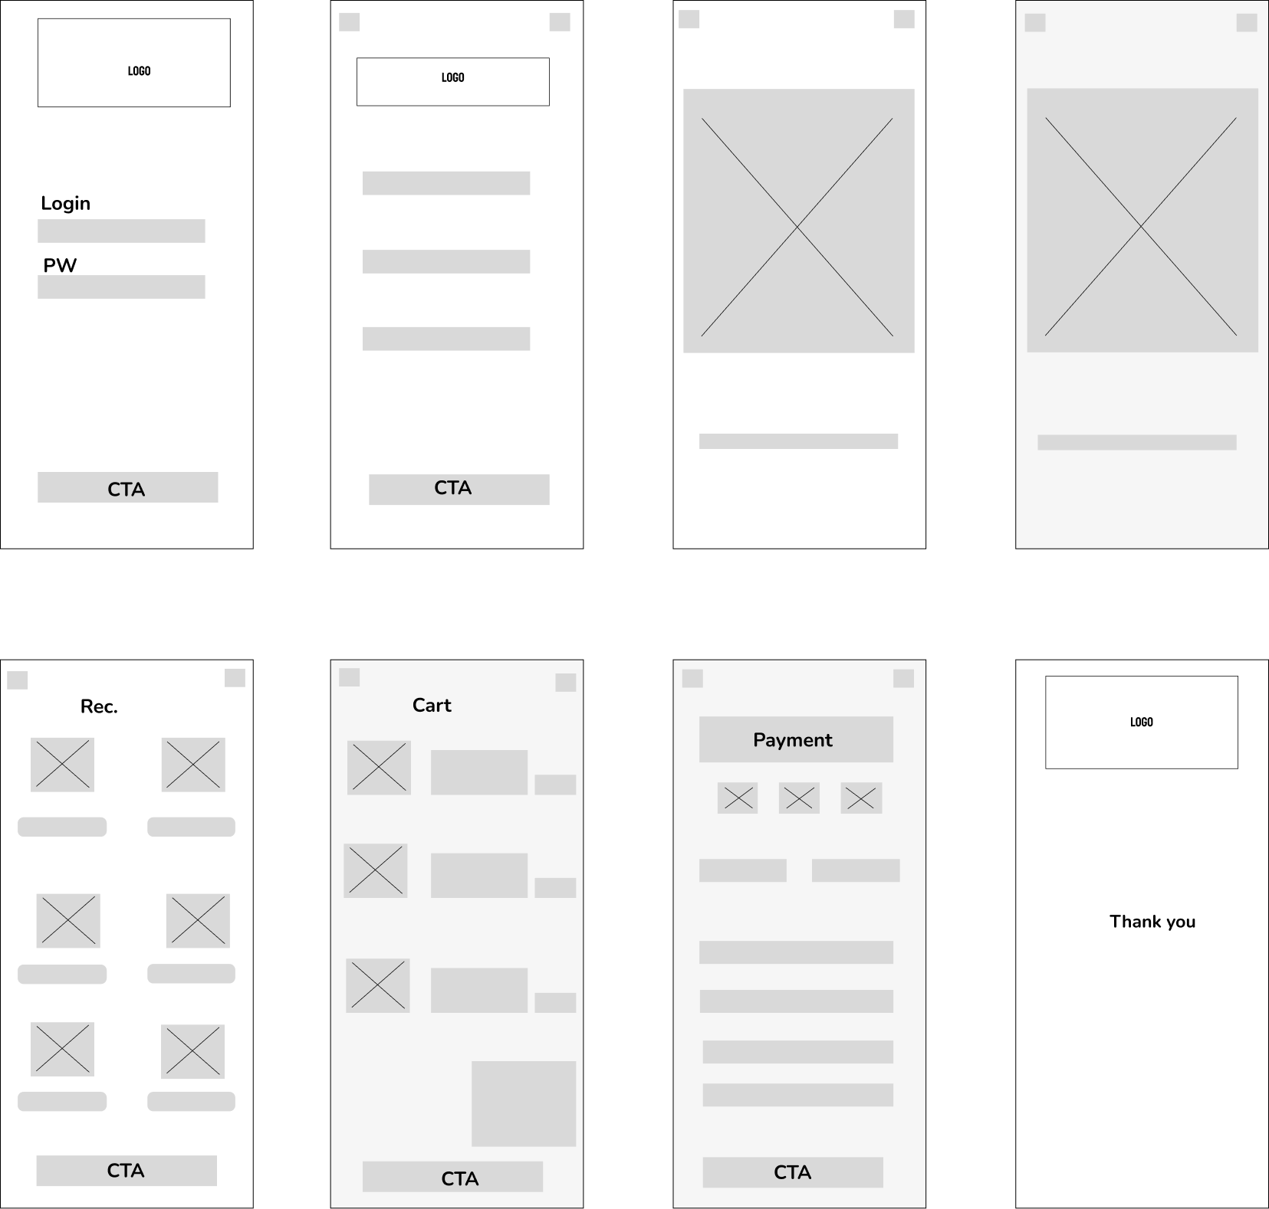
Notes:
And we decided to also build an app to scan the users face as some people don’t have a webcam for their computer. We did think through the process of just uploading a photo or a drag in drop on the website, but to get an accurate reading the photo must be live

Slide 97
Usability Testing Insight
One of our users was tasked to add a Smashbox foundation bottle to their bag. Then they were tasked to go through the checkout process. Afterward, the user was told to go through the skincare analysis app and buy the recommended products that were provided for them.
Overall, they had little to no difficulty going through the usability test. However, they had a hard time finding our products in the Omnisverse due to the lack of labels. They mentioned that they could not read the words that are on the product and would have liked to see what product they were hovering over.
Notes:
- One of our users was tasked to add a Smashbox foundation bottle to their bag. Then they were tasked to go through the checkout process.
Afterward, the user was told to go through the skincare analysis app and buy the recommended products that were provided for them.
- They mentioned that they could not read the words that are on the product and would have liked to see what product they were hovering over. So, we decided to incorporate that feature
In our hi-fidelity prototype

Slide 98
Welcome To The Omnisverse
Notes:
And finally, our prototype

